Slide 1
BLUE TAHITI Maximizer integration
Monetize Your B2B Data Directly Within The Maximizer Eco-system.

Slide 2
Benefits to the data owner
New channel for monetizing data assets
Win new business with a compelling offering that takes away the pain organizations face with legislative compliance
Powerful client lock-in and renewal incentive
Full control and reporting on data usage

Slide 3
Key features for the end user
1-Click update & enhance of leads/accounts with accurate channel, demographic & suppression info
Quick search &1-Click import of new prospects as accounts or leads
Scheduled bulk clean & enhance of accounts/leads
Scheduled bulk import of new prospects as accounts or leads

Slide 4
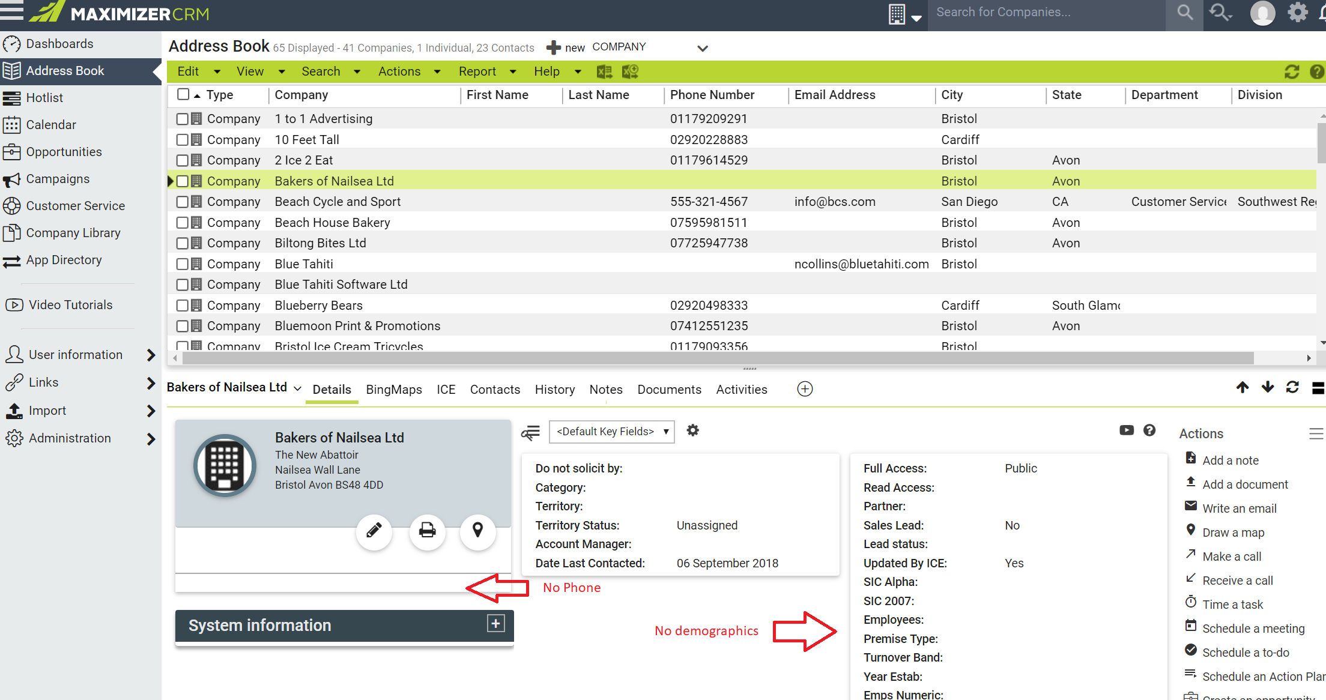
BLUE TAHITI – enhance basic records with new contacts, demographics and channel information, improving usability, targeting, compliance and more with a click

Slide 5
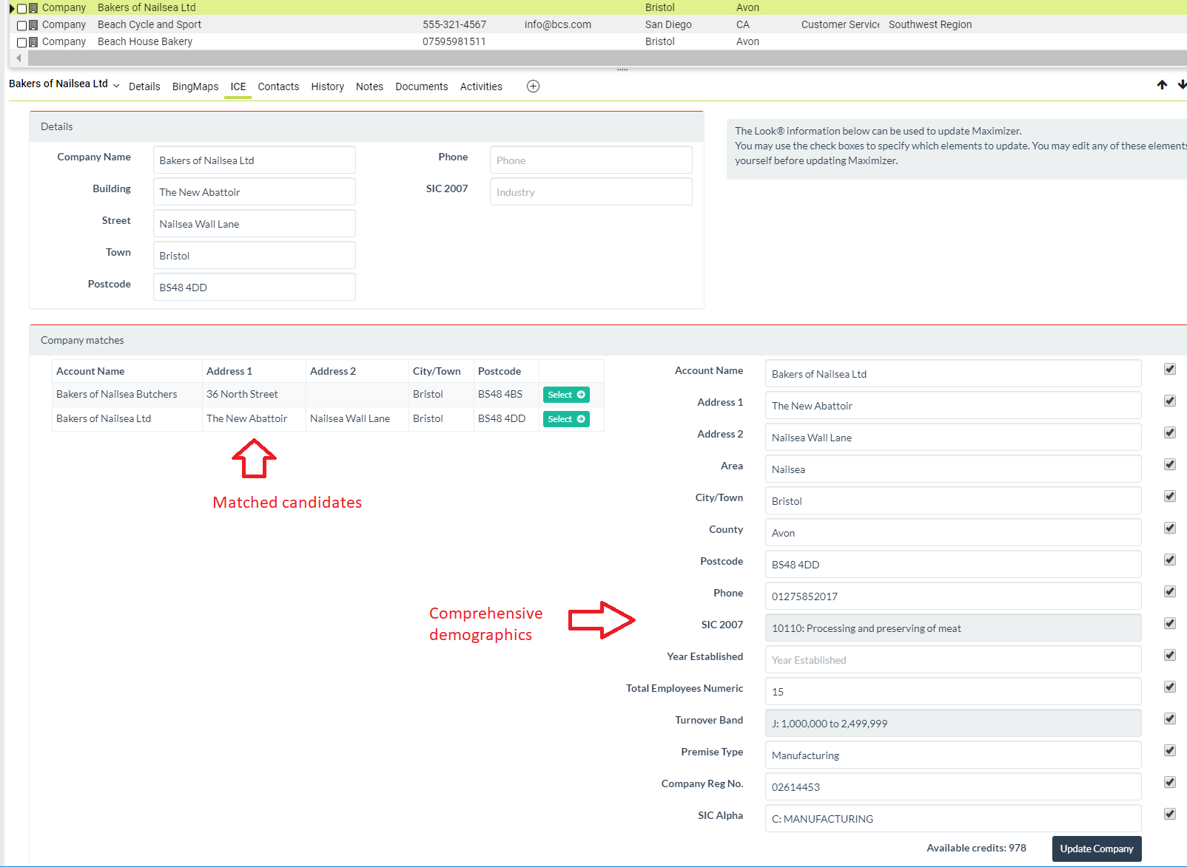
BLUE TAHITI searches for the account on the universe & shows possible matches

Slide 6
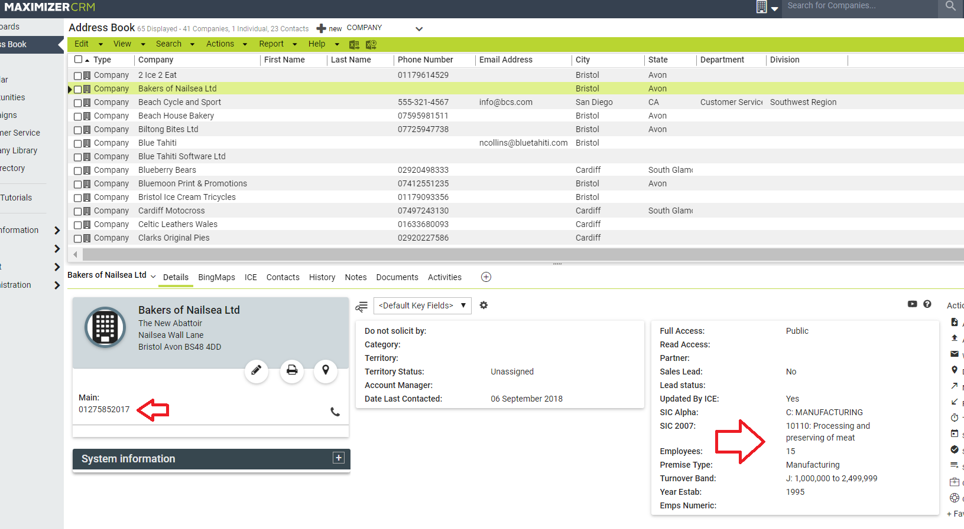
Maximizer record is updated with demographic and channel info, and new contacts

Slide 7
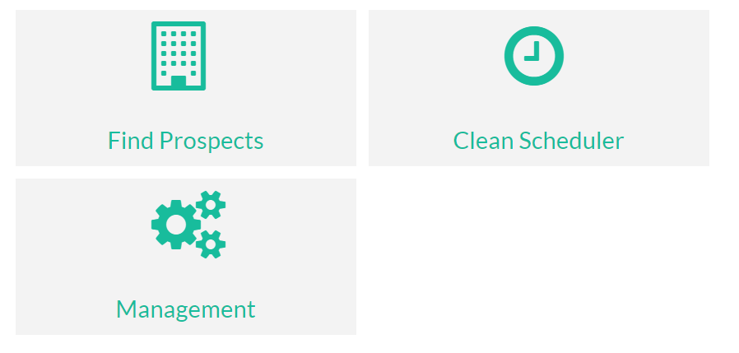
BLUE TAHITI for Prospects – search for and add new prospects with a click

Slide 8
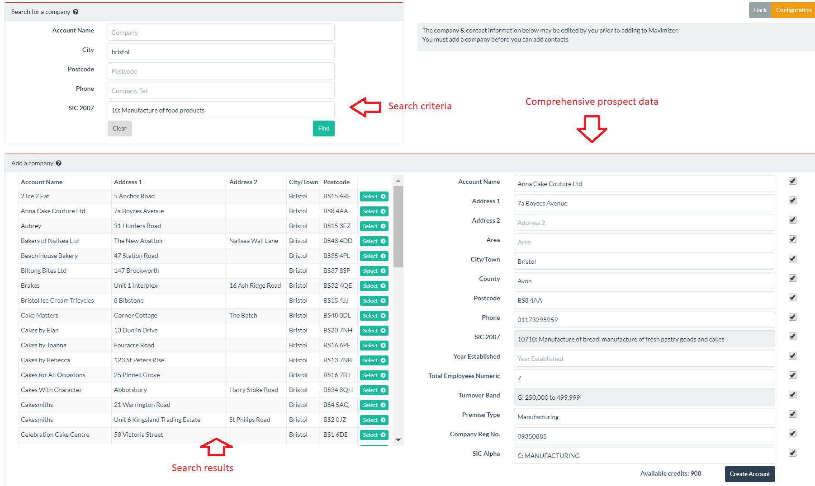
User specifies the search criteria and selects from the results the record to add to Maximizer. Once the account is added then new contacts may also be added

Slide 9
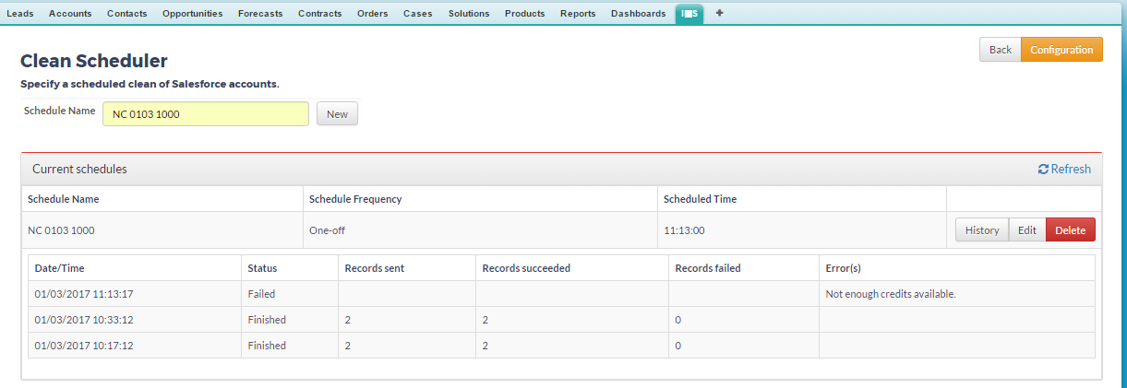
BLUE TAHITI Batch Clean and Enhance – clean batches of Maximizer records immediately or regularly.

Slide 10
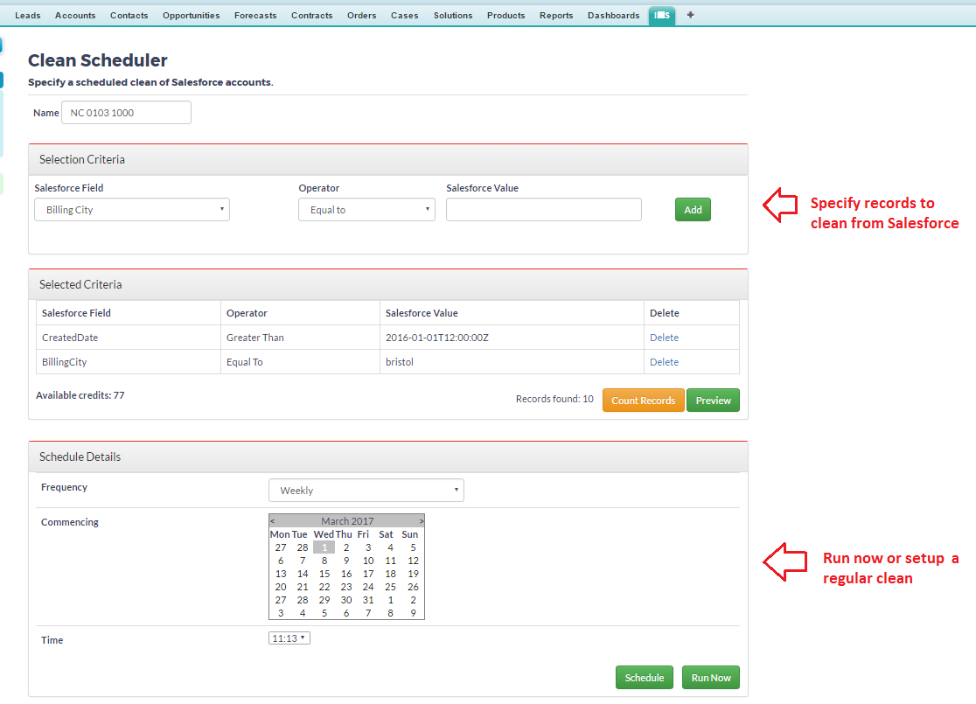
BLUE TAHITI Batch Clean and Enhance – clean batches of Maximizer records immediately or regularly.

Slide 11
1. Users need more targeted prospects for their campaign
2. User sets criteria
e.g. SIC
4. Hot new
prospects instantly
appear in Maximizer
Blue Tahiti
Plug-in
5. Locked-in revenue
stream
3. Plug-in queries
your list
Company
Address
Phone
Email
SIC
Employees
Sales Revenue
Your B2B list

Slide 12
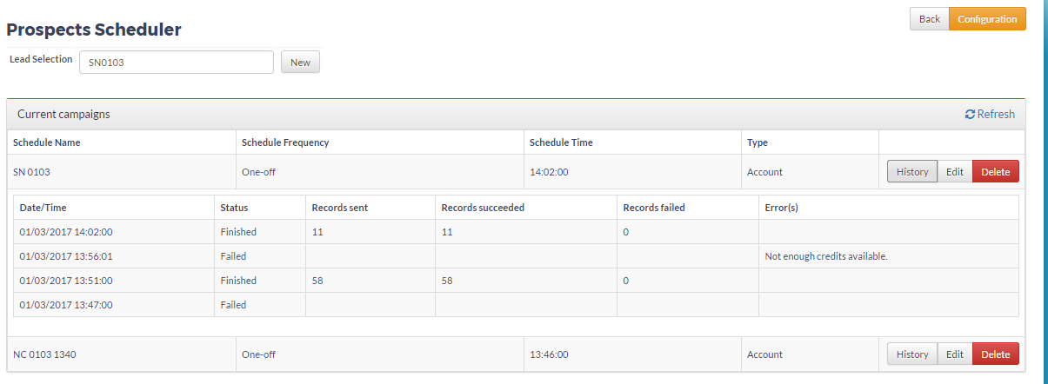
BLUE TAHITI Batch Prospects – Add new prospects in bulk either immediately or on a regular schedule

Slide 13
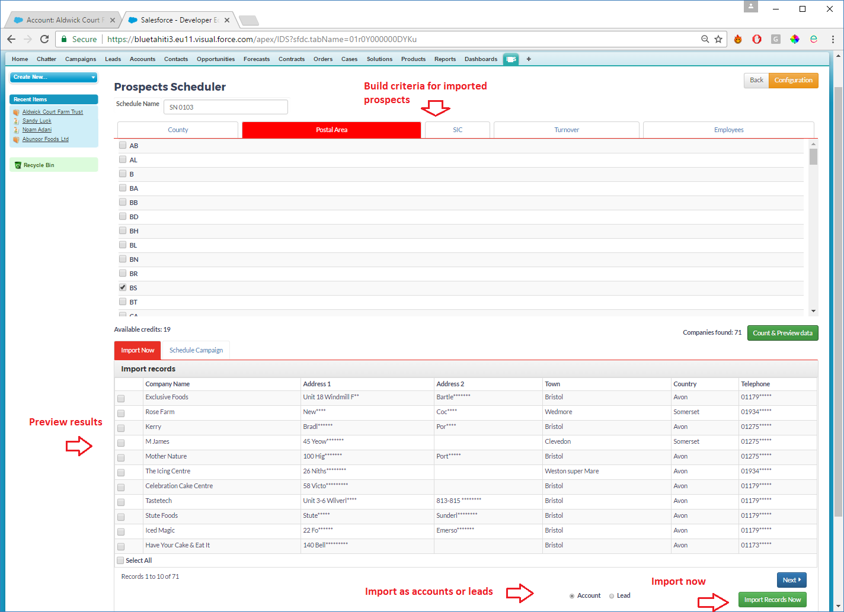
BLUE TAHITI Batch Prospects – Add new prospects in bulk either immediately or on a regular schedule

Slide 14
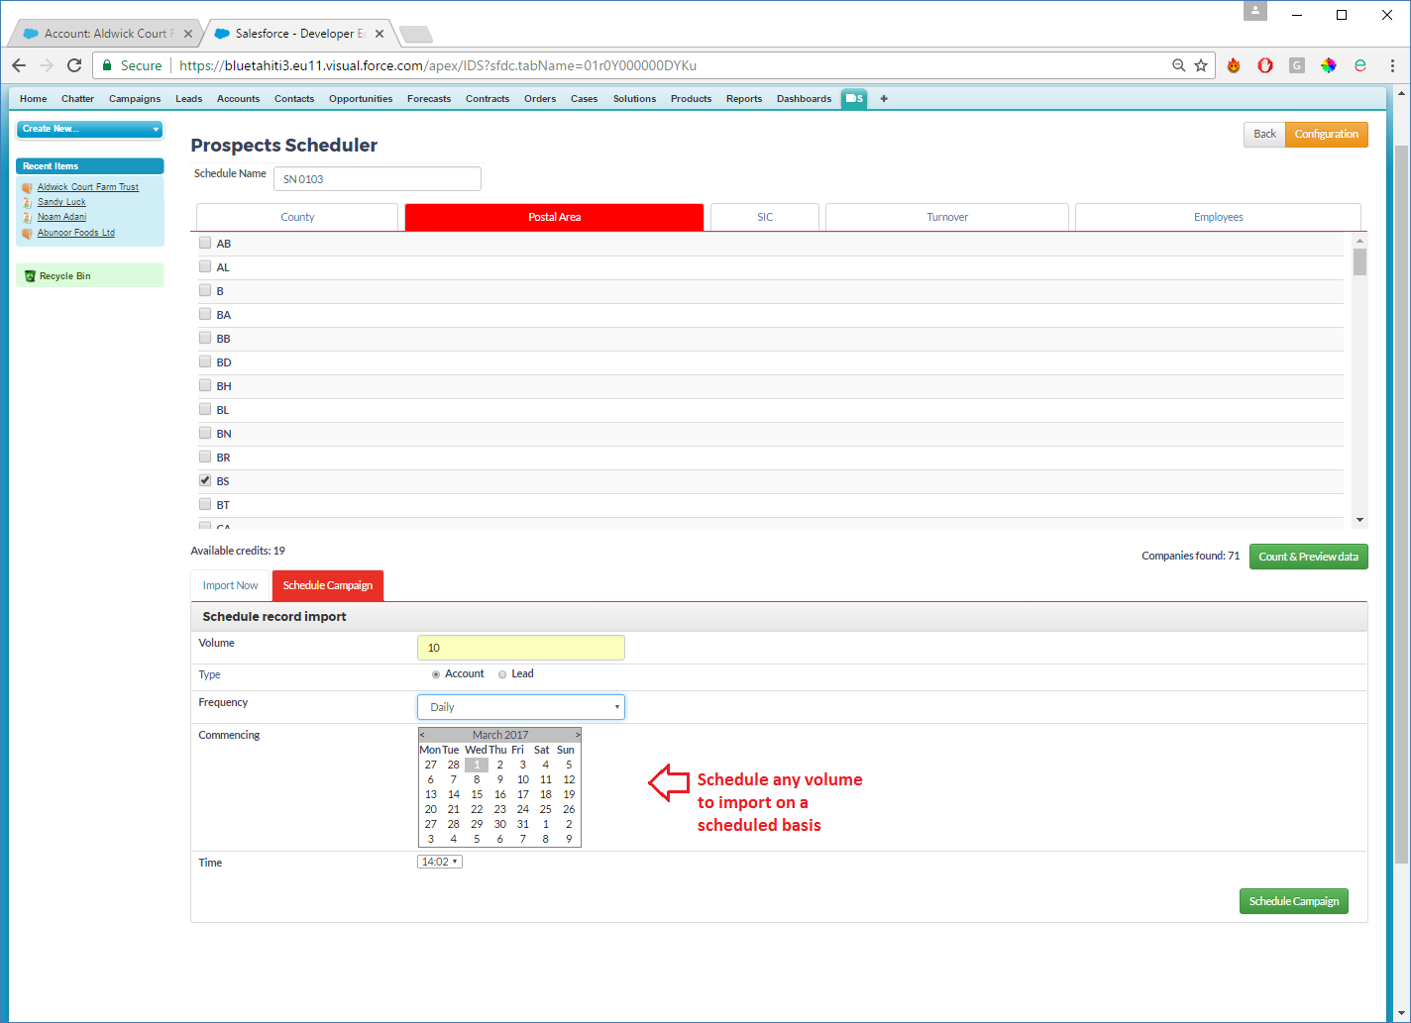
BLUE TAHITI Batch Prospects – Add new prospects in bulk either immediately or on a regular schedule

