Slide 1
Prospect Creator
Online prospecting e-commerce site for data owners

Slide 2
Why online?
Low operational cost allows small orders to be served economically
Reach new customers irrespective of location
Offer self serve ability to existing clients reducing costs
Part of an integrated platform of online services for data owners, offering new and innovative methods of driving revenue and reducing costs

Slide 3
How does it work
Anyone wishing to acquire prospects for a marketing campaign can select and downloaded targeted contacts in minutes using their web browser
Ideal for non data savvy users
Payment can be account or credit card based
Fully hosted means no software or hardware to worry about

Slide 4
Customised to your exact requirements
Configured specifically to work with your data whether it's B2B or B2C, whatever attributes you have
Support for multiple data usage scenarios
Fully branded to your corporate look and feel

Slide 5
White labelling
Offer your partners and resellers their own branded version so they can sell your data under their own banner
Rapid low cost setup and small cost of ownership

Slide 6
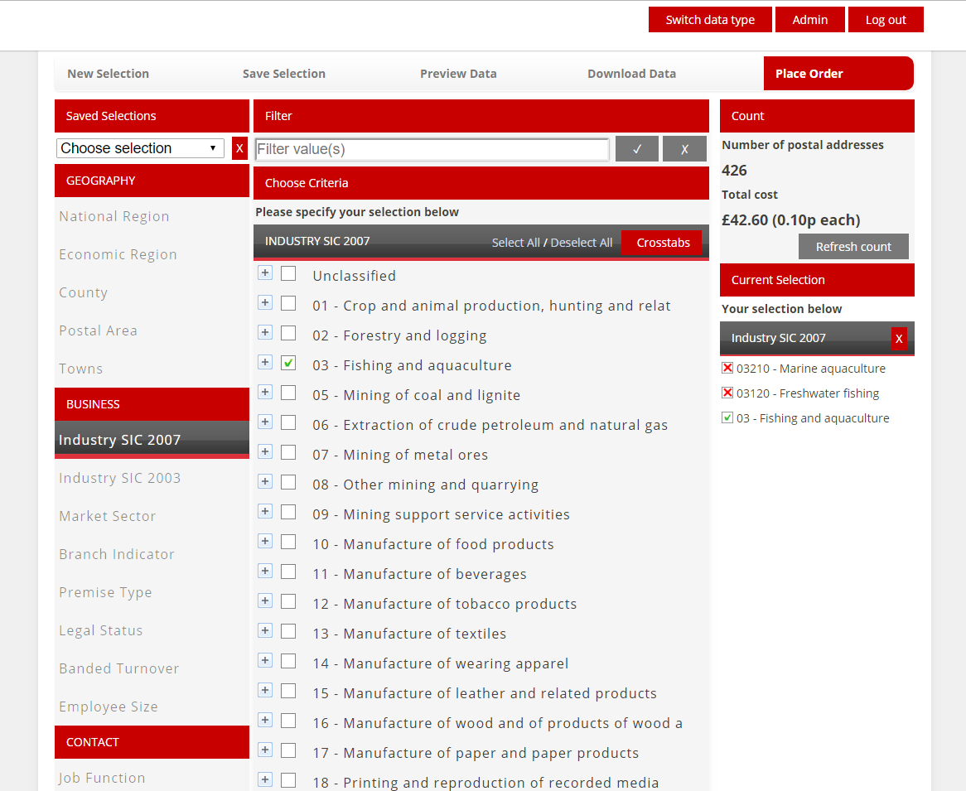
Embed into your website

Slide 7
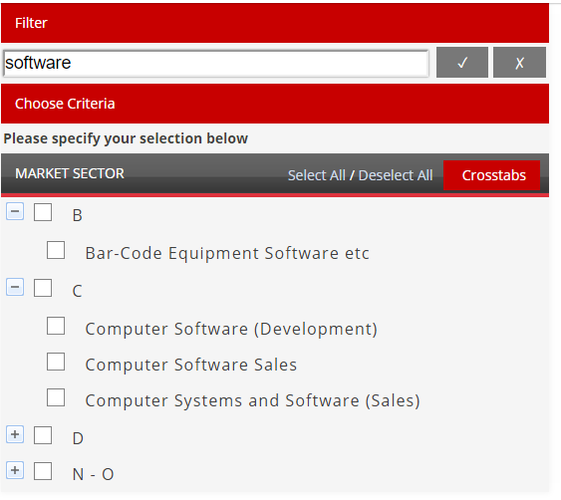
Easily find the right business
Simply start typing in the search box to find what you want

Slide 8
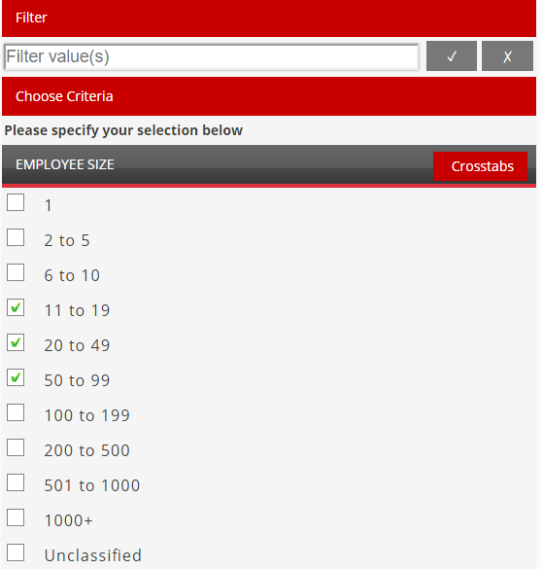
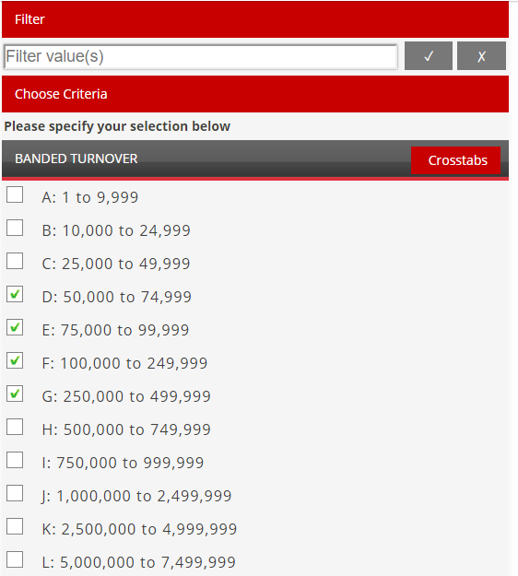
Get the size you want
Any selection available on your data can be used for filtering

Slide 9
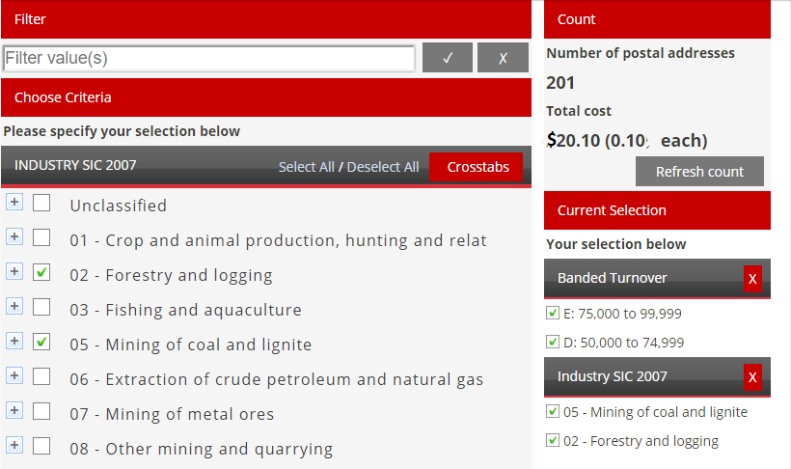
Instant Counts & Costs
Counts run in a few seconds even on large data sets

Slide 10
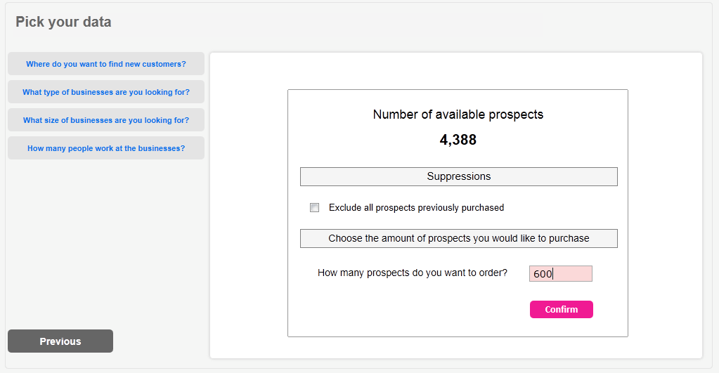
Specify the exact number of prospects

Slide 11
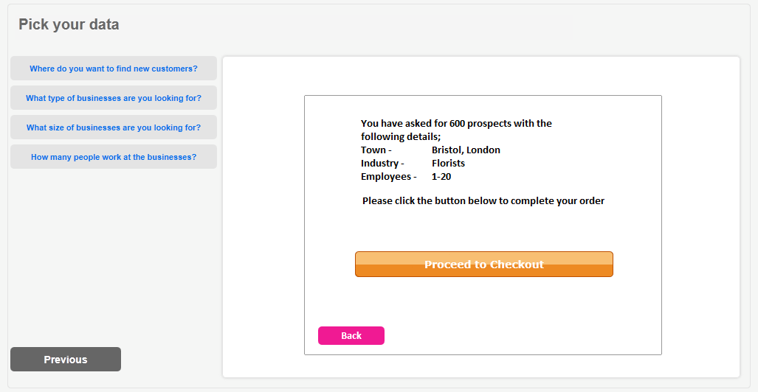
Place your order and check out
Credit card payments are processed directly to your bank

Slide 12
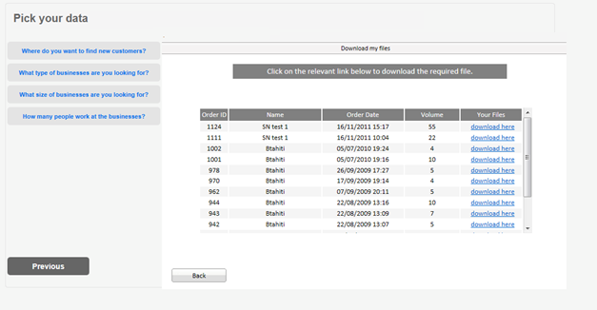
Download to Desktop
Users get their file immediately, no back office intervention needed

